Slide 1
Future of Blockchain
By Paras Dalal

Slide 2
General concept of Blockchain
Here is the definition as per Wikipedia
A blockchain is a growing list of records, called blocks, that are securely linked together using cryptography. Each block contains a cryptographic hash of the previous block, a timestamp, and transaction data (generally represented as a Merkle tree, where data nodes are represented by leafs). The timestamp proves that the transaction data existed when the block was published to get into its hash. As blocks each contain information about the block previous to it, they form a chain, with each additional block reinforcing the ones before it. Therefore, blockchains are resistant to modification of their data because once recorded, the data in any given block cannot be altered retroactively without altering all subsequent blocks.

Slide 3
General concept of Blockchain
Here is the definition as per Wikipedia
A blockchain is a growing list of records, called blocks, that are securely linked together using cryptography. Each block contains a cryptographic hash of the previous block, a timestamp, and transaction data (generally represented as a Merkle tree, where data nodes are represented by leafs). The timestamp proves that the transaction data existed when the block was published to get into its hash. As blocks each contain information about the block previous to it, they form a chain, with each additional block reinforcing the ones before it. Therefore, blockchains are resistant to modification of their data because once recorded, the data in any given block cannot be altered retroactively without altering all subsequent blocks.

Slide 4
General concept of Blockchain
Key Words:
Block
Data – Transactions, Timestamp, Previous block’s hash
Cryptography function
Hash
Distributed network

Slide 5
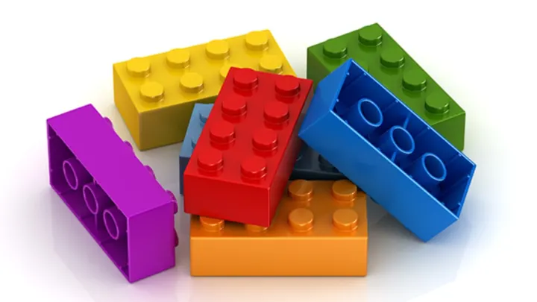



General concept of Blockchain
Cryptographic Function

Slide 6



General concept of Blockchain
Cryptographic Function
Slight Change in input will result in a totally different hash

Slide 7



General concept of Blockchain (mining)
Nonce
Cryptographic Function
Proof of Work
Notes:
Proof of work here is relevant for Bitcoin
There can be different kind of proofs – Proof of stake, Proof of storage (Filecoin)

Slide 8



General concept of Blockchain
Distributed Network of Nodes
Immutability

Slide 9
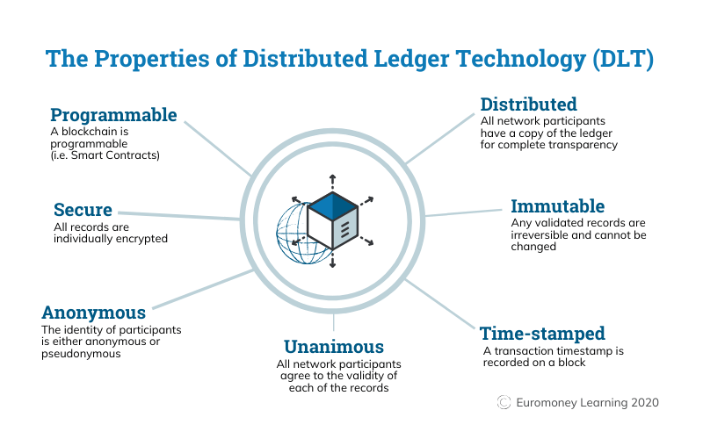
General concept of Blockchain
Blockchain is a type of Distributed Ledger Technology

Slide 10
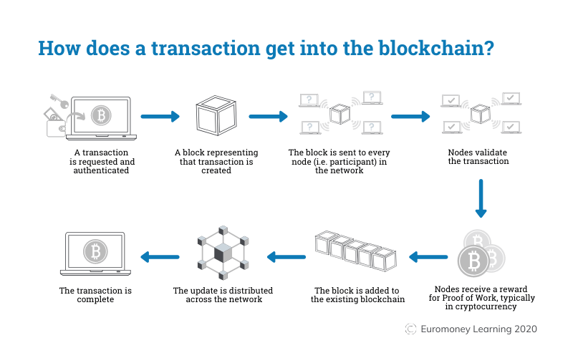
General concept of Blockchain

Slide 11
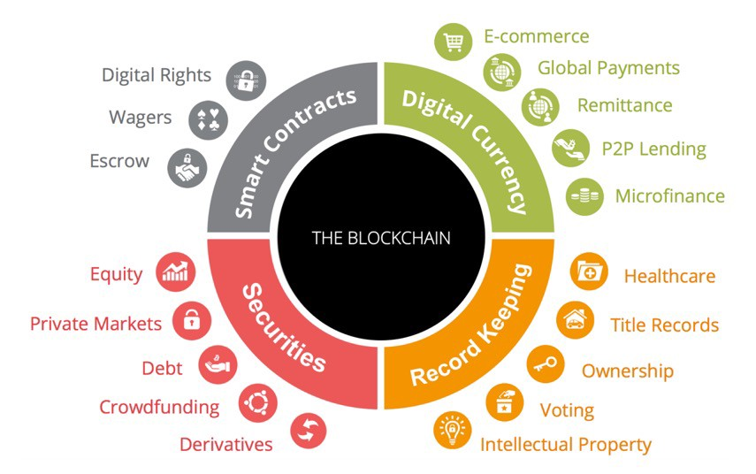
Future of Blockchain

Slide 12
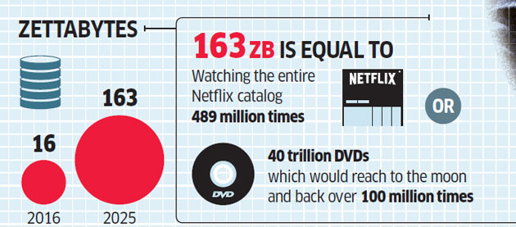
Example: Large Data
Data Overflow
1,000,000,000,000,000,000,000 (10²¹ = 1 Billion Terabytes)
Notes:
Example is FileCoin (Sia.tech)

Slide 13

Example: immutability (Financial Ledger)
Data Security

Slide 14
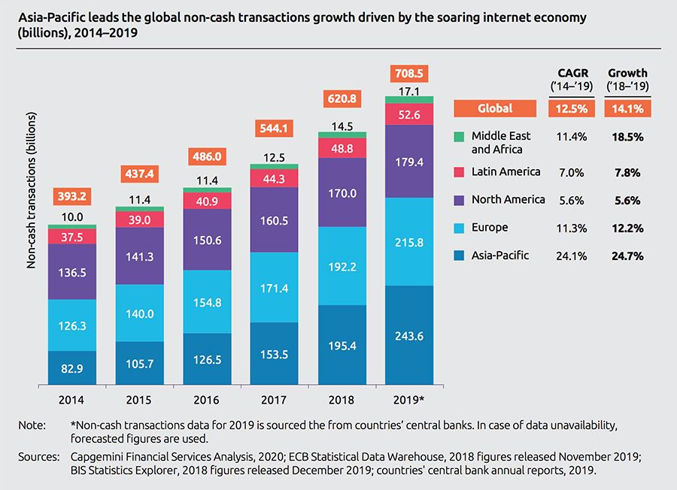
Example: Secure transactions without central authority
Transactions

Slide 15
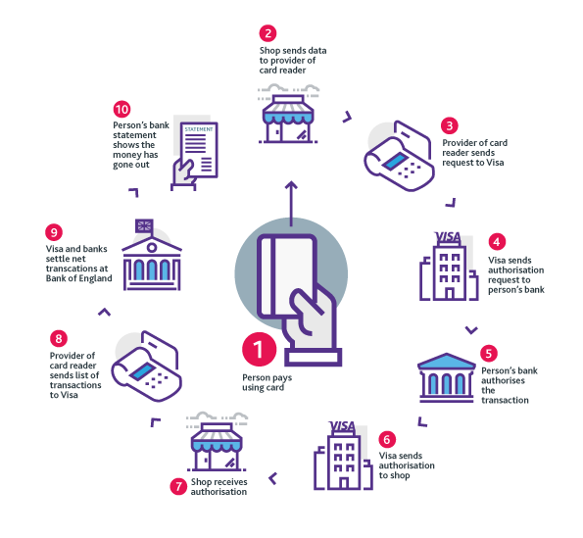
Common uses of Blockchain (Removal of Central Agency)
Intermediaries

Slide 16
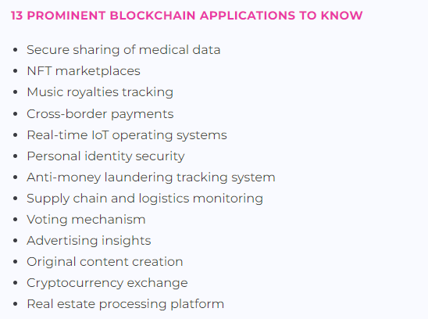
Future of Blockchain

Slide 17
Problems of Blockchain
Lack of governance due to early stage of technology
Proof of work requires vast amount of computing power and electricity
Majority stakeholder in mining can alter transactions
Potential misuse for illegal purposes due to ….
Large blockchain makes the speed of transactions slow

Slide 18
Relevance to Bessemer
May need to participate in various public blockchains
E.g. Zero day settlement using smart contracts
Crypto positions of our clients
May need to have private blockchain to reflect in our books
Speed of getting data to client
Private blockchain at our regional offices with historical data
Our clients may invest into digital assets
We need to be aware of underlying technology to guard their interests

Slide 19


